Slide 1

Smart Grids
Enabler for the future energy supply
Prof.dr.ir. Han Slootweg
Delft, March 17th, 2016

Slide 2
Agenda
Enexis as DSO
Electrical power system
Energy transition
Smart Grids as an enabler
Challenges and next steps

Slide 3
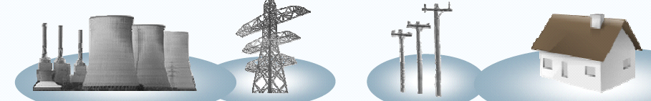
Organisation of the Dutch energy sector
Liberalized
Regulated
Liberalized
Produc-
tion
Trans-
port
Distri-
bution
Supply
Related
businesses
Large scale
Operator 110
–
Enexis
, Alliander,
Delta, Dong,
Enexis
generation: Delta,
380kV: TenneT
Endinet, Rendo,
Electrabel, Eneco,
Other parties, such as
Installation companies
Eletrabel, Eneco,
Import & export
Stedin, Westland
E.ON Benelux, Essent
Electricity
E.ON, Essent, Nuon
Energie, Delta
(RWE), Nuon
Other decentralised
Netwerkbeheer,
(Vattenfall), NEM, etc.
generation
Cogas, etc.
Import
Maatschap
Operator HP grid
Enexis
, Alliander,
Delta, Dong,
Enexis
Groningen: a co
(40-60 bar) Gas
Endinet, Rendo,
Electrabel, Eneco,
-
Stedin, Westland
E.ON Benelux, Essent
Other parties, such as
Installation companies
operation between the
Transport Services
Energie, Delta
(RWE), Nuon
Gas
State, Shell and
(GTS)
Netwerkbeheer,
(Vattenfall), NEM, etc.
ExxonMobil
Import & export
Cogas, etc
Enexis
, Delta (Zebra
HD leiding)

Slide 4
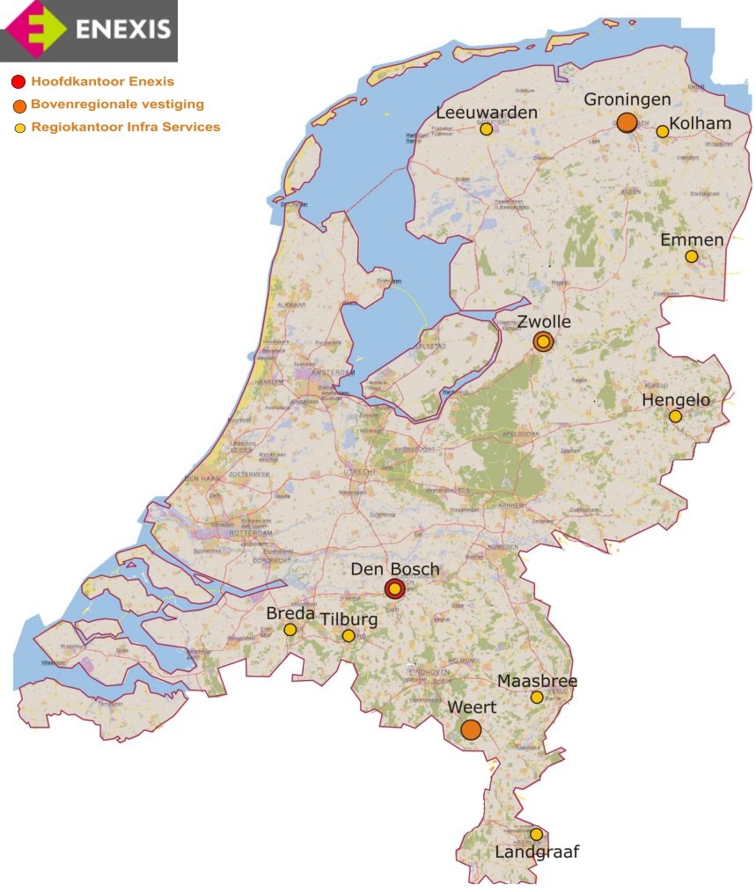
Facts and figures Enexis
Employees:
App. 4.300
Branches:
12, mainly in East-NL
Turnover (2015):
1.353 MEURO
Profit after taxation:
223 MEURO

Slide 5
Facts and figures Enexis
Electricity:
2,7M connections
148,000 km MV / LV grid
53,000 stations
Gas:
2,1M connections
45,000 km grid 0.03-8 bar
25,000 stations
  Gas
Electricity + Gas

Slide 6
Activities DNOs - Enexis
Realization of network connections for new energy producers and consumers
Expanding networks for connecting construction areas and for meeting changing requirements of existing/connected consumers (i.e. load growth or connection of distributed generators)
Replacement of grid components at end of technical life
Inspection (including gas leakage detection) and maintenance (periodic and condition based) of grid components
Outage restoration
Collection and distribution of measurement data
Reconstructions of gas and electricity due to third party construction activities (buildings, roads, etc.)
Non-regulated activities, such as rental of MV/LV transformers and MV switchgear

Slide 7
Agenda
Enexis as DSO
Electrical power system
Energy transition
Smart Grids as an enabler
Challenges and next steps

Slide 8
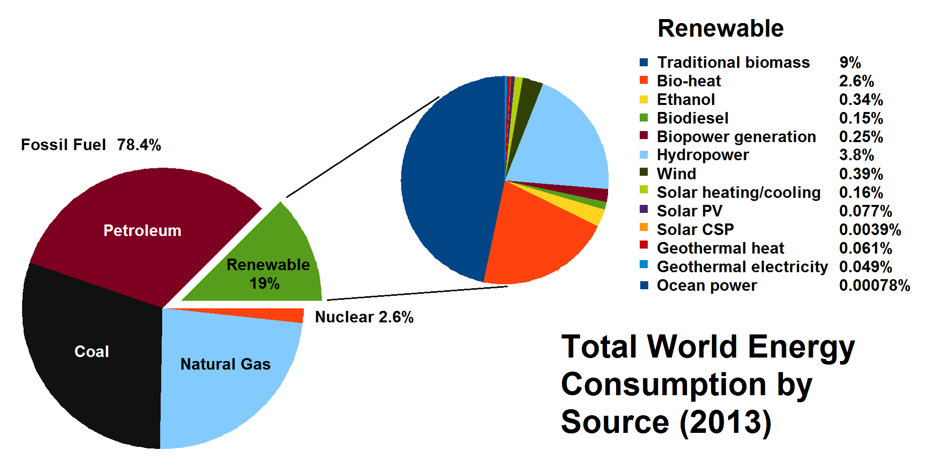
Energy consumption by primary energy source - world

Slide 9
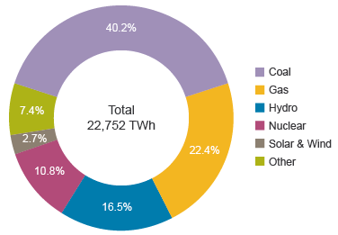
Electricity generation by primary energy source - world

Slide 10
Electric power system in the 20th century
Large generators have higher efficiency than smaller ones – most electricity generated in large scale power plants
Electricity flow mainly “top-down”
Electricity can not be stored cost effectively in large quantities, i.e. at “utility scale”
Supply of and demand for electricity must be continuously balanced
At present, most consumption is time-critical and inflexible
Supply and demand are balanced by adjusting supply to demand
Rotating masses in generators act as a buffer between supply and demand
Grid frequency reflects the extent to which a balance between supply and demand exists
In the longer term, demand is followed by committing and stopping power plants

Slide 11
Electric power system in the 20th century

Slide 12
Agenda
Enexis as DSO
Electrical power system
Energy transition
Smart Grids as an enabler
Challenges and next steps

Slide 13
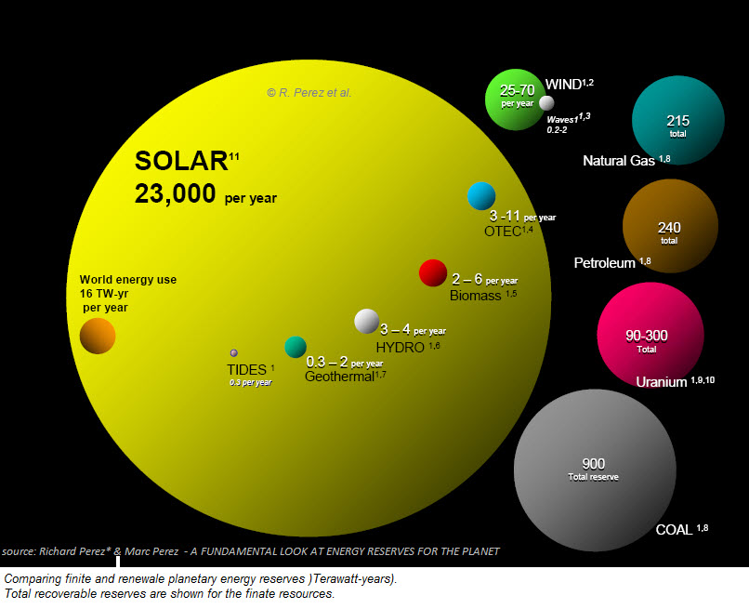
Sustainable energy abundantly available…

Slide 14
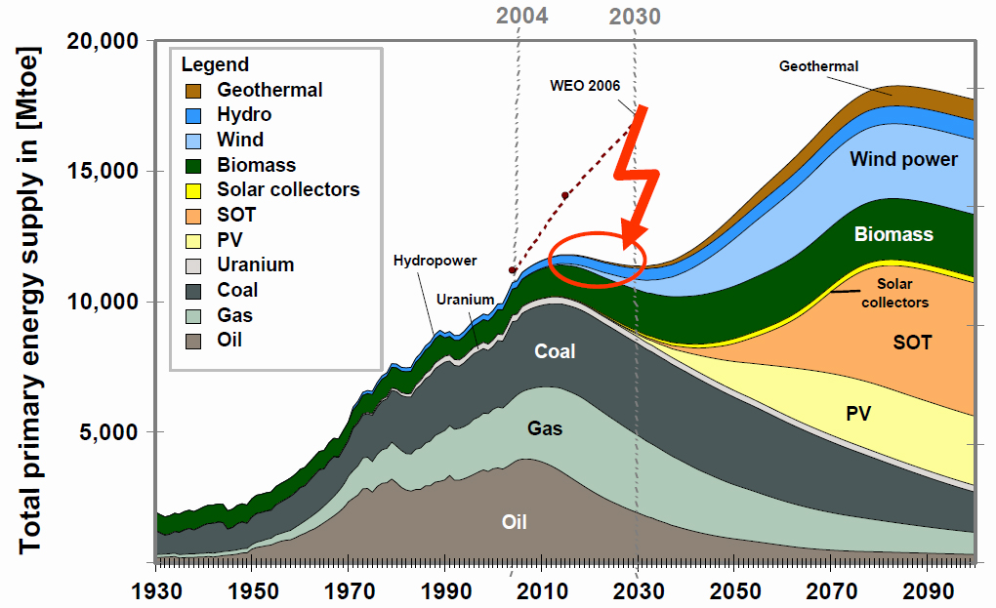
…but transition takes time!

Slide 15
Consequences of the energy transition
Contribution of electricity will increase
- Most technologies for sustainable energy generation produce electricity
- Increased energy efficiency leads to substitution of gas and liquid fuels by electricity
Scale of electricity/energy production will decrease
- Make use of waste heat produced by thermal electricity production (difficult to transport)
- Low energy density of renewable energy sources
Controllability of electricity/energy production will decrease
Amount of flexible consumption will increase
- Electrification of less time critical applications such as mobility and heating

Slide 16
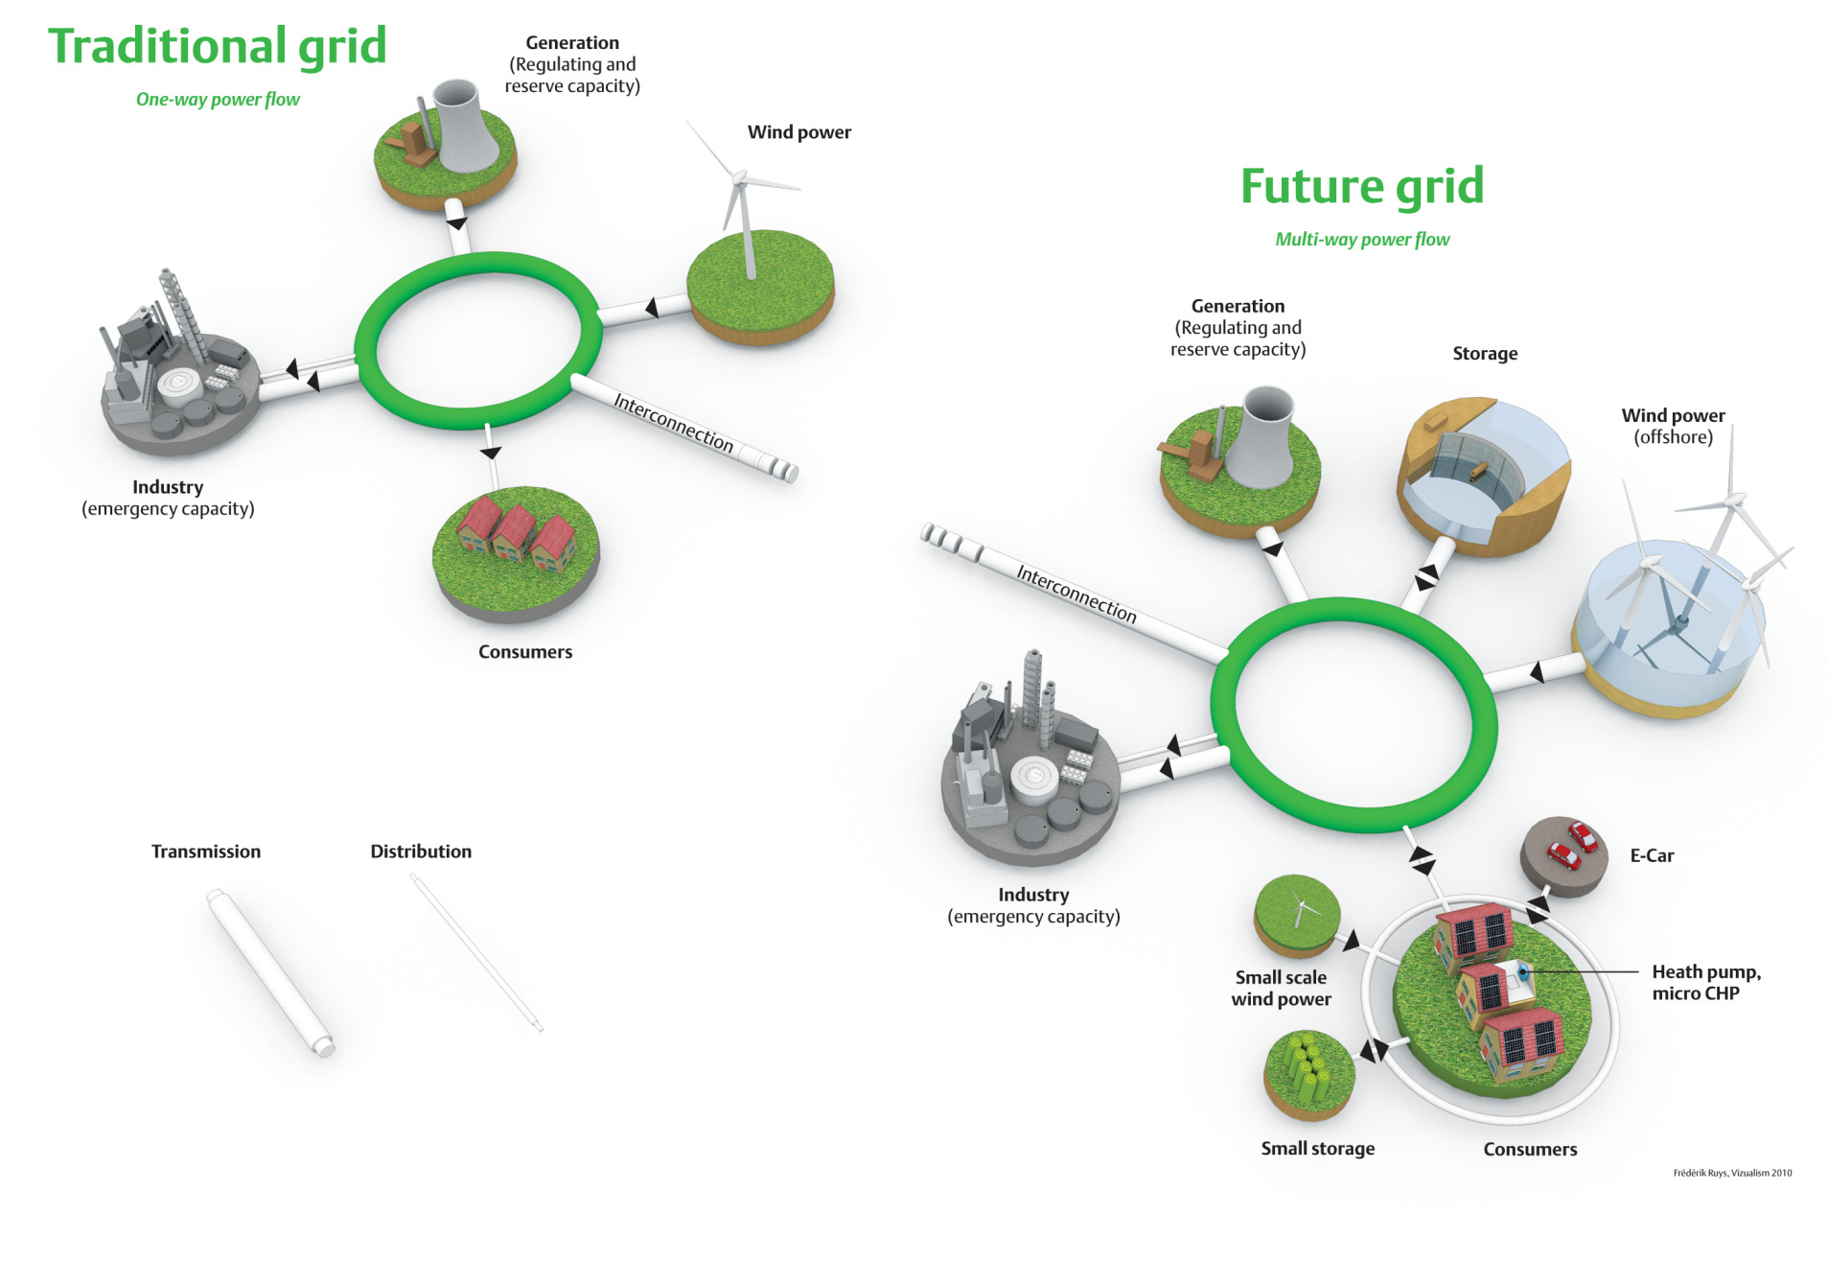
20th vs 21st century power system

Slide 17
Agenda
Enexis as DSO
Electrical power system
Energy transition
Smart Grids as an enabler
Challenges and next steps

Slide 18
Increasing information exchange in a sustainable energy supply
Increasing information exchange is required in the future electrical power system compared with the present electrical power system, because:
Generation becomes distributed, uncertain and uncontrollable
Load becomes increasingly flexible, and this flexibility “behind the meter” must be mobilized for optimal operation of the power system,
Balancing supply and demand becomes more complex because of reduced controllability of generation, increased flexiliblity of load and storage facilities
More advanced tariff schemes will be implemented and new commercial propositions will be offered
New actors, such as energy cooperations and local microgrids are expected to enter the market
Grid operators may want or need to discriminate between time-critical and flexible consumption during peak loads or exceptional circumstances

Slide 19
Smart Grids – enabler for the increasing information exchange
A Smart Grid is:
An electricity network with technologies that make available information on the energy flows in the network
and the state of its components
and that allow control of energy flows in order to support the energy transition efficiently

Slide 20
Smart Grid Architecture
Important design considerations in a smart grid architecture:
Division of roles and responsibilities over grid operators, market parties and consumers and resulting exchange of information
Required/Desired measurements and control-actions
Initiation (time-based or event-based) and refresh-rate
Bandwidth and total information load
Type(s) of communication network(s) required
- Internet (VPN)
- Power Line Carrier
- Wireless
- Dedicated telecommunication network (fiber, CDMA)
Integration of (smart) home and (smart) grid

Slide 21
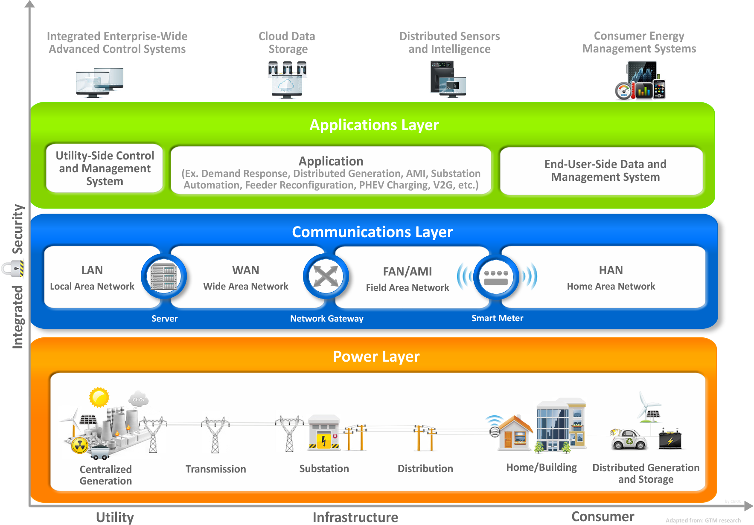
Smart Grid Architecture Model

Slide 22
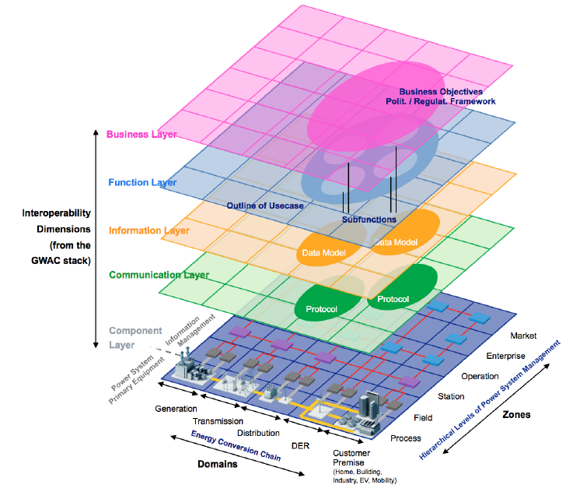
Smart Grid Architecture Model

Slide 23
Agenda
Enexis as DSO
Electrical power system
Energy transition
Smart Grids as an enabler
Challenges and next steps

Slide 24
Challenges and next steps
Transition to a sustainable energy supply is required but takes time
This energy transition strongly affects electrical power systems:
- Increasing role of electricity as an energy carrier
- Downscaling electricity generation
- Decreasing controllability of electricity generation
- Increasing flexibility of consumption
“Traditional” electrical power systems are not able to cope with these challenges
Smart Grids deliver the intelligence required for a reliable, affordable and sustainable future electrical power system
Architectural concepts for Smart Grids are still under debate and enabling technologies are under development

Slide 25
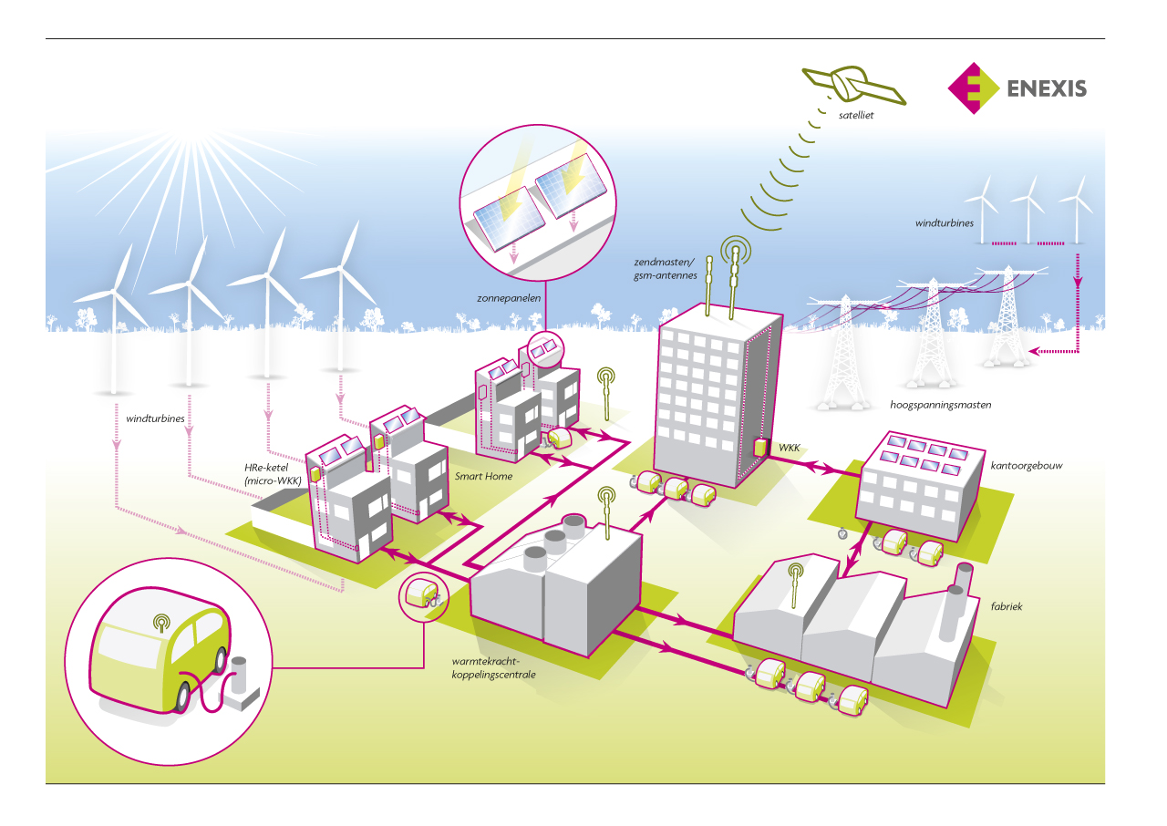
Smart Grids - Our common future*
Title of a report issued in 1987 by the World Commission on Environment and Development (WCED), generally considered to first ever put sustainablity on the global agenda

